Slide 1
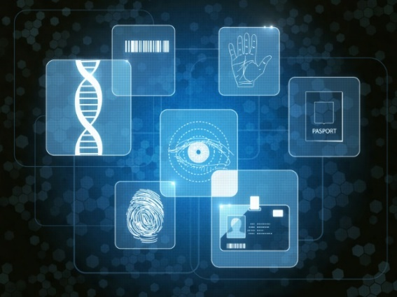
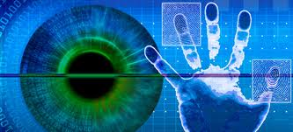
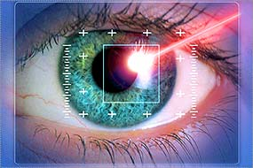
Triplet Loss based Deep Learning Frameworks for Off-angleIris Recognition
Daniel Tebor and Mahmut Karakaya
Imaging Research and Information Sciences Laboratory
Dept. of Computer Science
Kennesaw State University
April 6, 2025
Notes:
Hello, my name is Hasim Oz, I am a graduate student at Kennesaw State University.
Today I will be presenting the research findings in Comparison of Recognition Fusion Methods for Left and Right Off-angle Iris Images.
First, I will give a brief introduction about iris recognition and challenges in standoff systems. Then, I will explain the proposed fragile bit method for off-angle iris recognition. Finally, I will share the experimental results.

Slide 2
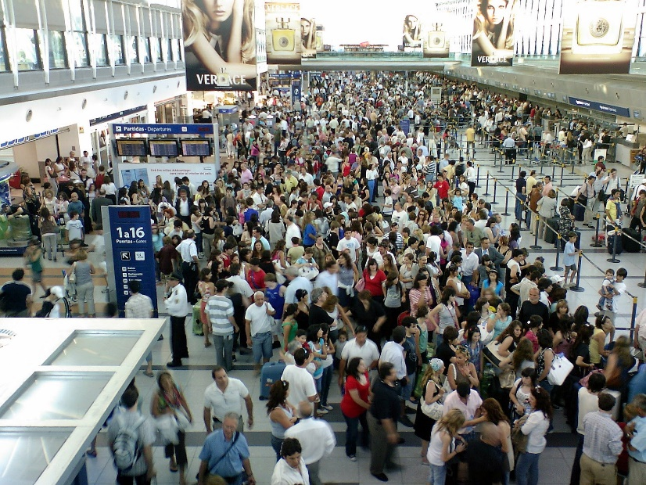

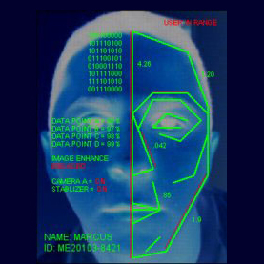
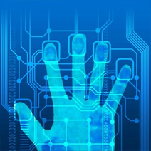
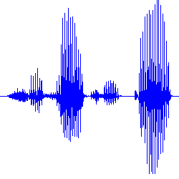
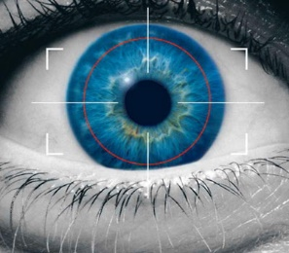
Background and Motivation
The identity management to strengthen global security.
Subject credential is important.
With millions of people passing sensitive locations ever day.
The need of high efficiency access control.
Biometrics used broadly as the technology to verify the identification.
The use of biometric systems becoming increasingly common.
2/19
Notes:
With millions of people passing sensitive locations every day, Identity management is more important than ever as we seek to strenghten global security to make our life safe and secure. Biometrics is defined as being the physical and behavioral characteristics of subjects, including but not limited to fingerprint, face, and iris.
Usage of biometrics have been broadly implemented as the technology of choice to lock down the credentials to identify subjects from passport control to criminal identification systems.

Slide 3
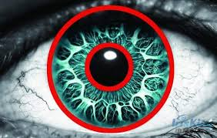

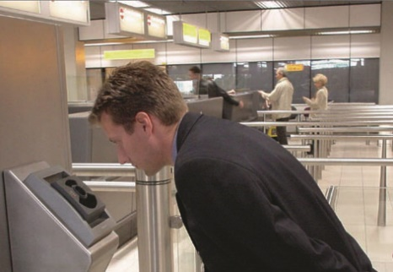
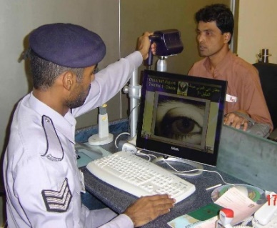
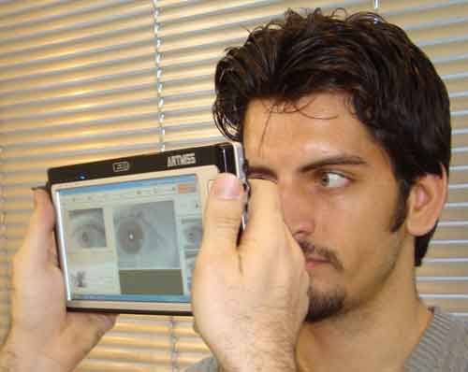
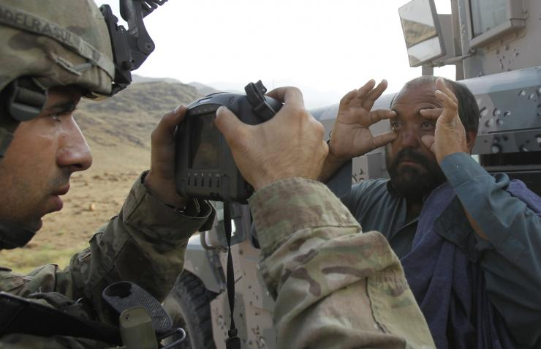
Background and Motivation
IRIS:
Colored part of the eye.
Unique and most stable biometrics in the human body.
More accurate biometrics than fingerprint or face.
Iris recognition providing
Strong security,
Higher usability,
Nonintrusive.
Despite the superiorities, not been widely used due to its cumbersome and time-consuming procedures.
3/19
Notes:
Iris is the colored part of the eye.
It is unique and the most stable biometrics in the human body.
Therefore, it provides
Strong security,
Higher usability, and
Nonintrusive
Biometrics.
However, iris recognition has not been widely used because its technology is cumbersome and time consuming.
It requires to user stop, position themselves close to the camera, and remain there for several moments.
Until now,

Slide 4
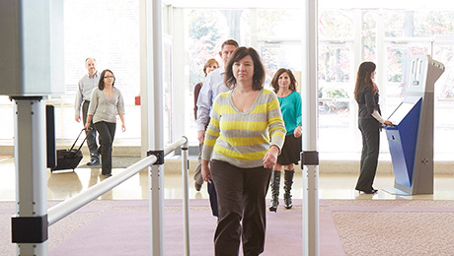
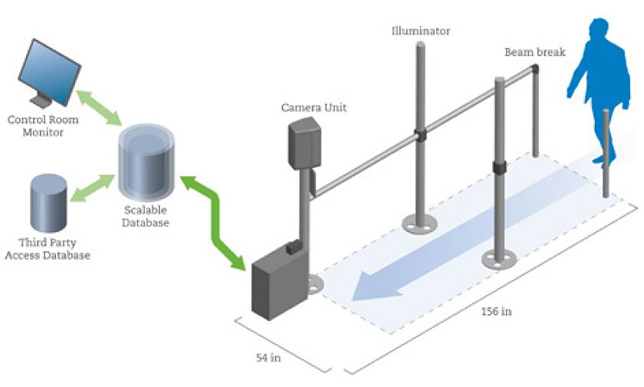
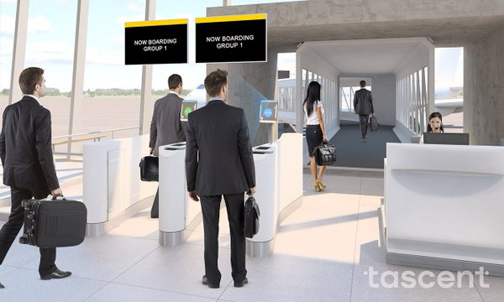
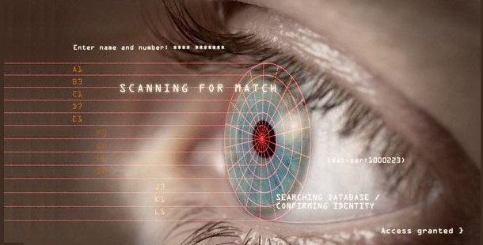
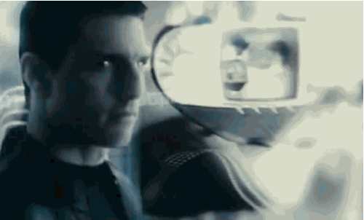
Background and Motivation
Stand-off Biometrics System Benefits:
Enable to keep the camera several feet from the subject
Allowing to move while capturing
Accurate identification without being invasive
Fast, convenient, high throughput solution.
The biometrics at high traffic locations.
Perfect for any access control application
airport, border crossing, point of sale.
Subject in the motion.
Requires only a glance.
4/19
Notes:
Among other biometric solutions, iris recognition has been referred as one of the best due to the its reliability, distinctiveness, and accuracy.
Stand-off systems require only a glance and enables the camera to be several feet from a subject, while also allowing movement of the subject. This allows them to provide accurate identification without being invasive to individuals.

Slide 5
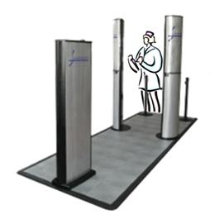
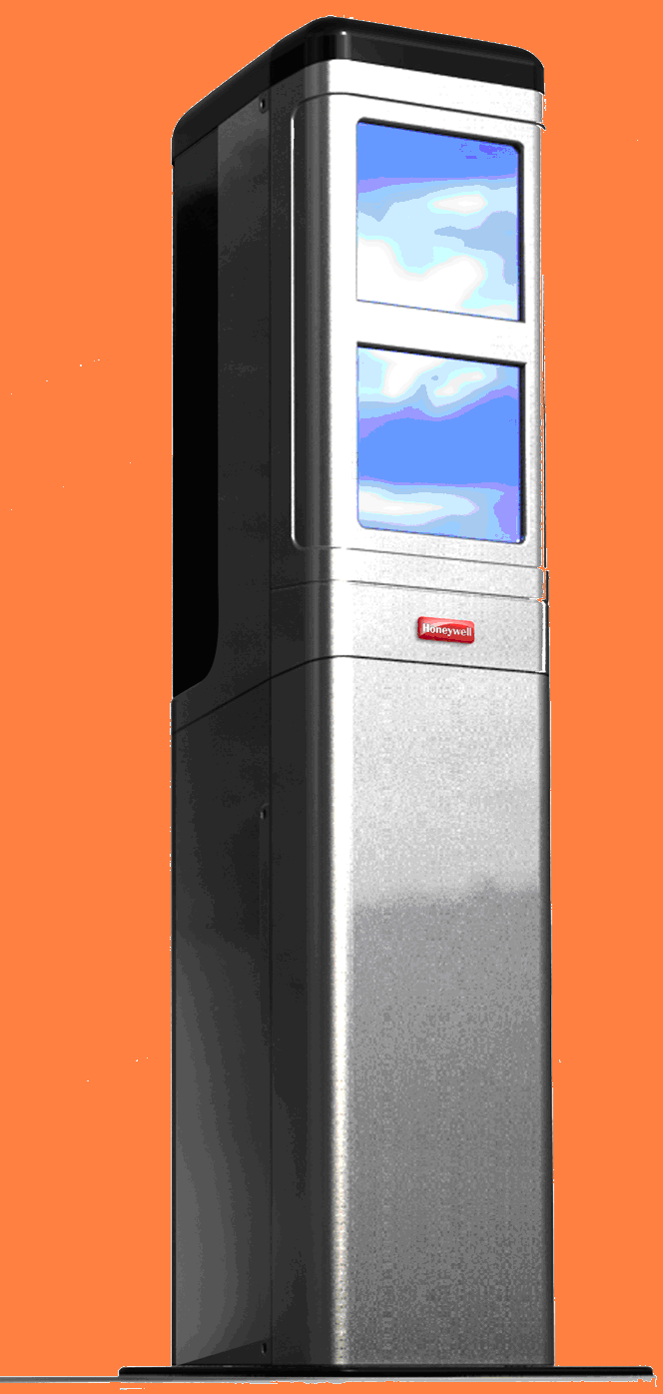
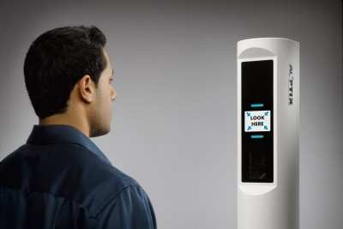
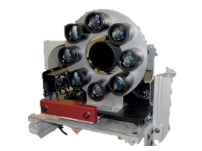
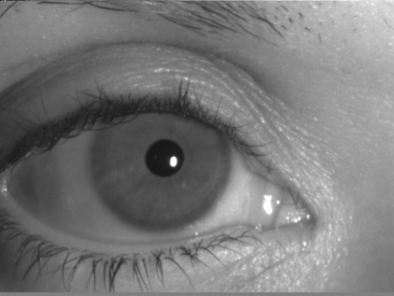
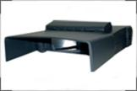
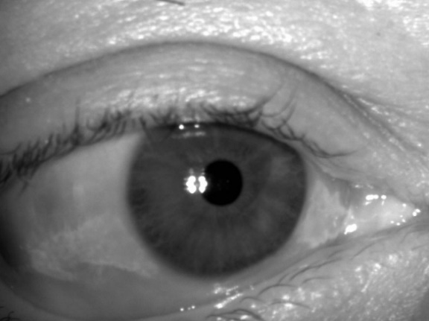
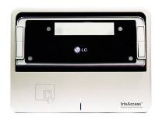
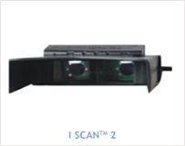
Stand-off iris recognition Systems
Iris On the Move PassPort™ (Sarnoff)
Honeywell CFAIRS
AOptix Iris Scanner
ORNL Standoff Multimodal Biometric System
ISCAN 2
LG IrisAccess
5/19
Notes:
Now imagine the challenge of managing people entering such a critical facility.
Standoff systems deliver a fast, convenient, high throughput solution to recognition. Which revolutionized the biometrics captured at high traffic locations.
There is now technologies present which allows to capture touchless biometrics that provides immediate access to the facility.
Examples of stand off systems are provided in this slide.

Slide 6
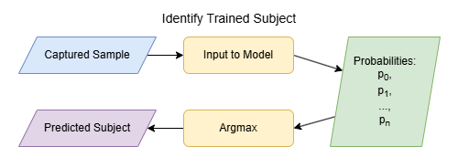
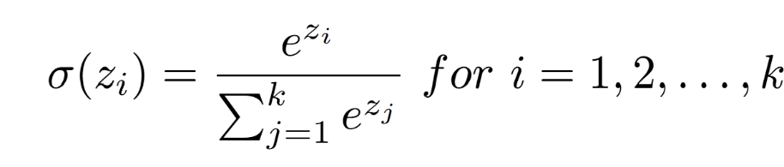
Closed World
Closed world -> Known subjects. No new subjects added post-training
Most iris deep learning research uses closed-world
Softmax:

Slide 7
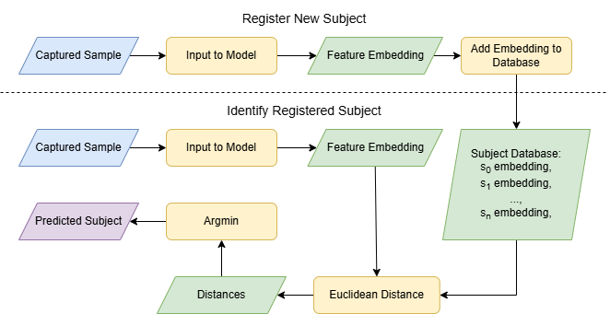
Open World
Open world -> New subjects registered in database. Model must be generalized.
This is most iris biometric systems.

Slide 8
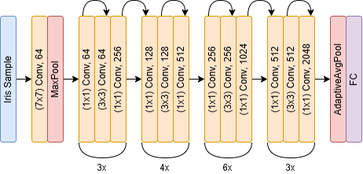
Deep Learning Architecture
We utilize ResNet50 for its robust feature extraction
Good results in previous research
FC is removed to output 2048-dim feature embeddings

Slide 9
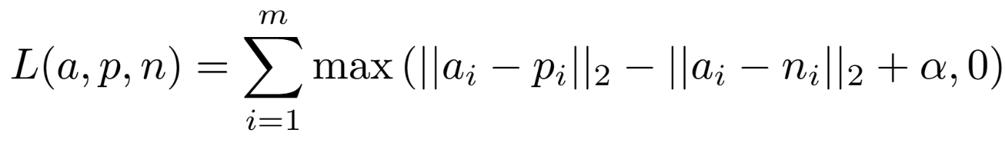
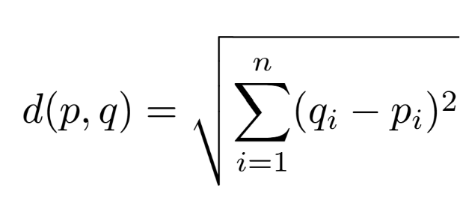
Triplet Loss
Triplet loss goals:
Minimize distance between embeddings of same subject
Approach margin distance between embeddings of different subjects
Uses anchor, positive, and negative sample
Embeddings can be compared with Euclidean distance

Slide 10
Hard Mining
Hard mining is when anchor and negative samples are similar
Usually done by measuring similarity between samples using some metric
Instead, we define an angle constraint between anchor and negative samples

Slide 11
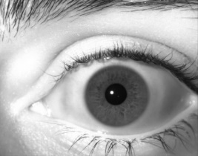
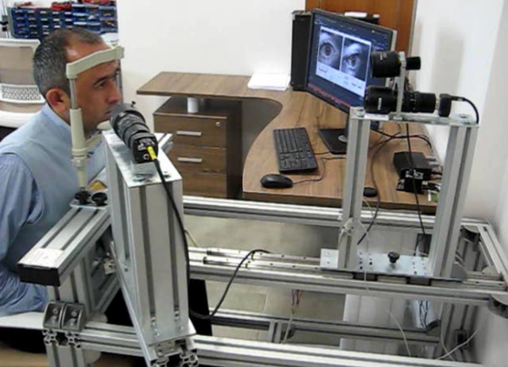
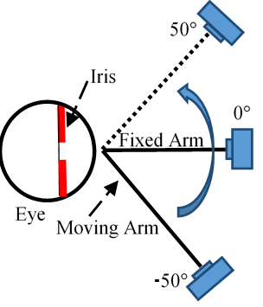
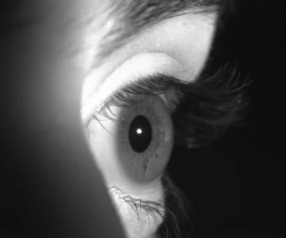
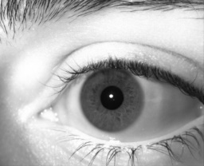
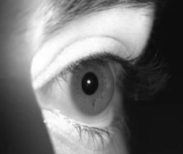
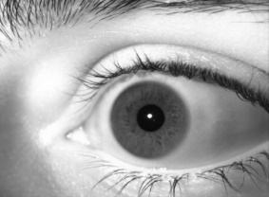
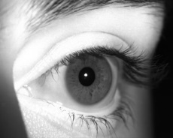
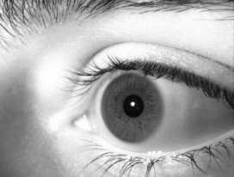
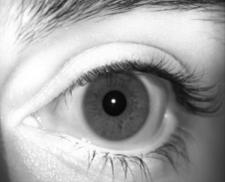
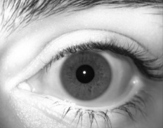
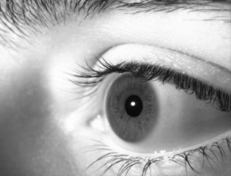
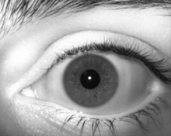

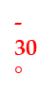
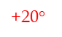
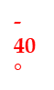
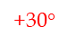






Experimental Setup and Dataset
-10$°$
+50$°$
-20$°$
+40$°$
-30$°$
+30$°$
Iris Dataset:
22000 iris images from 100 different subjects,
Camera:
60 images per second (1280x1024) with NIR sensitivity,
Frontal and Off-angle camera at 108 mm and 40mm focal length.
Setup:
Each subject placing their chin into a chin rest with a forehead support,
Frontal camera captures frontal iris images
Off-angle camera captures off-angle iris images.
Off-angle camera rotates from -50º to 50º with the increment of 10º.
-40$°$
+20$°$
-50$°$
+10$°$
0$°$
11/19
Notes:
We tested the proposed fragile bit method for off-angle iris images with a dataset of 11000 images from left eye of 100 different subjects.
Figures show the data capture platform and captured sample off-angle iris images.
All images captured with IDS cameras under a NIR light source.
Frontal iris images are captured when camera is at 0° in angle and subjects look at directly to the camera.
For off-angle images, the camera moves horizontally on a rotational arm from -50° to +50° in angle and captures 10 images at every stop with a 10° step-size.

Slide 12

Iris Data Collection Platform
Notes:
To address these challenges, we first developed a new iris data collection platform using two cameras.
Frontal and off-angle cameras capture iris images at the same time.

Slide 13











Frontal and Gallery Databases
Most deployed iris datasets have a frontal capture sample for registered subjects
Databases could be expanded to include a gallery of samples with different capture angles
Gallery
Frontal
+

Slide 14
Training and Evaluation
ResNet model trained with dataset of 80 subjects
AdamW optimizer with lr=1e-4 & weight decay=1e-3
Batch size=64
Preprocessing and augmentations applied to the samples during training
Model is evaluated at each angle w/ other 20 subjects
For evaluation, ROC curves computed with similarity scores between embeddings are used
t-SNE is also computed

Slide 15




Results for Frontal Database Scenario
Model evaluated at each angle compared w/ frontal
Excellent performance
Performance degradation for angles other than 0 (frontal)
POM 0 and 20 are best
+/- 0
+/- 20
+/- 50
Unbound

Slide 16




Results for Gallery Database Scenario
Model evaluated at each angle compared w/ itself
Almost perfect performance
POM 50 and Unbound models have worse performance
+/- 0
+/- 20
+/- 50
Unbound

Slide 17




t-SNE Subject Groupings
Clear separation between different subjects
No embeddings are misplaced in wrong cluster
Shape of clusters could have to do with angles
+/- 0
+/- 20
+/- 50
Unbound

Slide 18
Closing Remarks
What was done:
Train ResNet50 using off-angled iris images and triplet loss function using varying degrees of hard mining
Evaluate model on dataset of separate subjects to evaluate model in an open-world scenario
How it was done:
Custom iris dataset was configured to produce anchor, positive, and negative triplets
Model was trained using finetuned hyperparameters and weights from the best epoch were saved
Findings:
Models trained with hard mining and soft hard mining showed state of the art performance for frontal iris datasets.
Performance was nearly perfect for gallery datasets.
Model is able to extract meaningful feature embeddings from subjects it never saw during training.
Who to Thank:
Secure and Trustworthy Cyberspace (SaTC) program of The National Science Foundation (NSF) award CNS-1909276 and CNS-2100483.
Notes:
This study employed the deep learning network AlexNet, through transfer learning, to improve recognition performance for standoff images.
By utilizing a deep learning network instead of the Gabor-based traditional recognition algorithm, and rather than analyzing a single iris, we investigated decision fusion techniques to combine results from both eyes, improving reliability and overall recognition performance in biometric systems.
We trained with frontal and tested with off-angle ocular images our network.
Based on the results of Fused Model, we can conclude the following:
Mean Fusion: Achieves high accuracy by balancing predictions from both iris models,
Max Fusion: Achieves performance equivalent to Mean Fusion by selecting the highest prediction,
Min Fusion: Significantly lower performance due to reliance on the lowest prediction scores, resulting in low-confidence recognition accuracy, and iv) While decision fusion does not necessarily improve accuracy beyond the best-performing single-eye model, it remains the one of the best approach to combine results from both eyes.
Based on the results of Single Model, we can conclude the following:
The single-model approach, trained with frontal and tested with off-angle on left and right irises together, achieved the best performance.
Based on the results of Single Model, we can conclude the following:
The single-model approach, which combined left-right and right-left iris images and trained both irises together, failed to achieve consistent and reliable recognition performance.
The overall conclusion is that using AlexNet with transfer learning and training it with frontal and off-angle iris images helps improve recognition accuracy for off-angle images and makes biometric systems more reliable. This study shows that decision fusion techniques can effectively combine results from both eyes, while the single-model approach trained with frontal images delivered the best performance. These findings highlight the value of deep learning-based standoff recognition systems, which work better than traditional methods in handling gaze variations.

Slide 19

Questions?

